Slide 1
FINAL PROJECT: VIDEO GAMES SALES
GROUP #9
NAVEEN ABBOJU
KAROL KUCZYNSKI
HANY JAGWANI

Slide 2
INTRODUCTION
The dataset is all about Video game sales. It gives the latest and most up-to-date information on how VGChartz games are performing in the market, including current trends and predictions for the future. Keep track of the products’ performance and learn about which techniques are working for other games in the different genres.

Slide 3
OBJECTIVES
SEMMA Process
To implement a Machine Learning model that can classify the global sales of a video game depending on certain attributes such as its genre, platform, and year

Slide 4
PLAN FOR PREDICTING THE DATA
SAMPLE
EXPLORE
MODIFY
MODEL
ASSESS
Generating a representative sample of the data
Visualization and basic description of the data
Select variables, transform variable representations
Use a variety of statistical and machine-learning models
Evaluate the accuracy and usefulness of the models

Slide 5
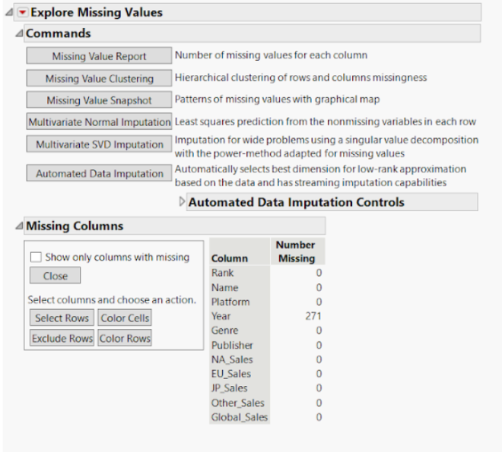
EXPLORING MISSING VALUES

Slide 6
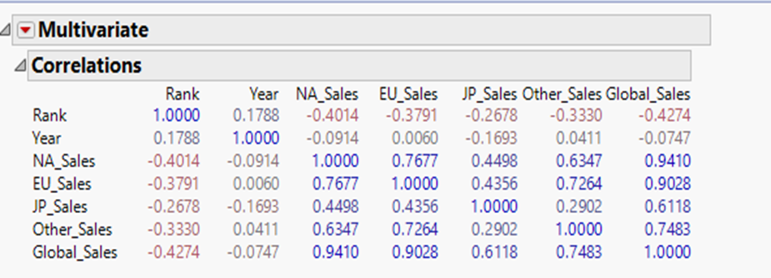
CORRELATION

Slide 7
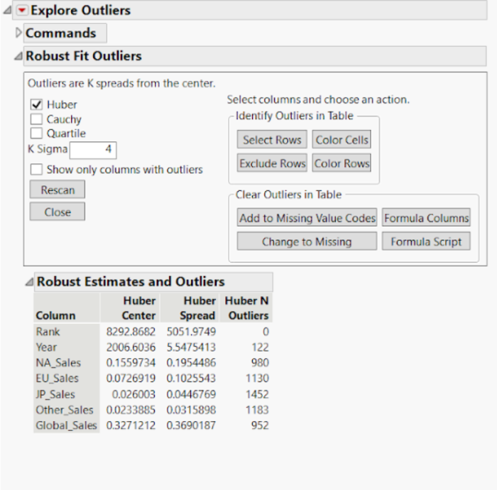
OUTLIER ANALYSIS

Slide 8
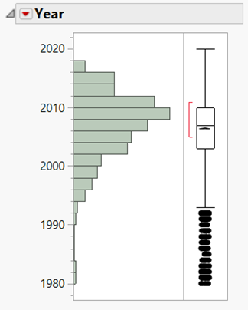
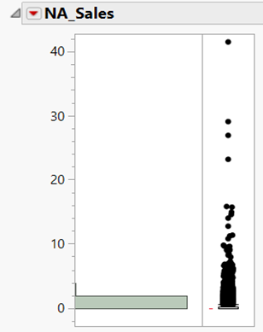
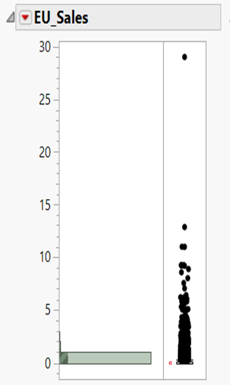
OUTLIER ANALYSIS

Slide 9
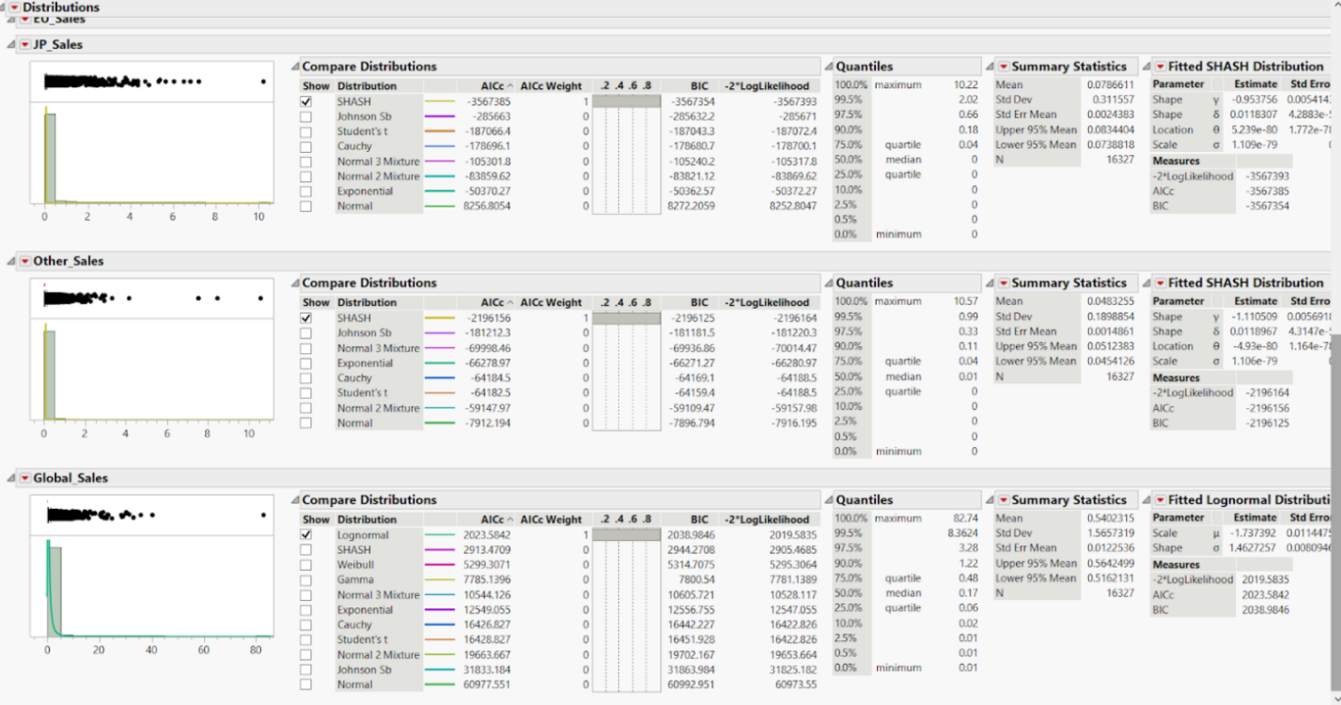
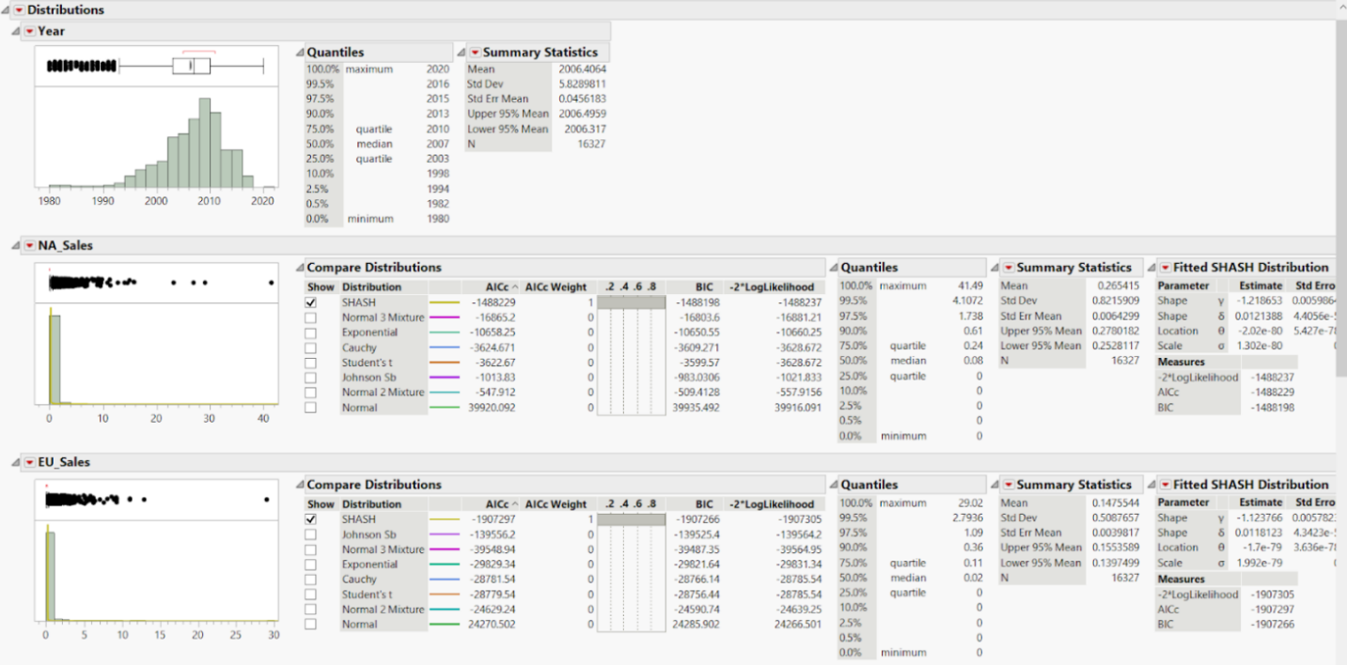
TRANSFORMED VARIABLES

Slide 10
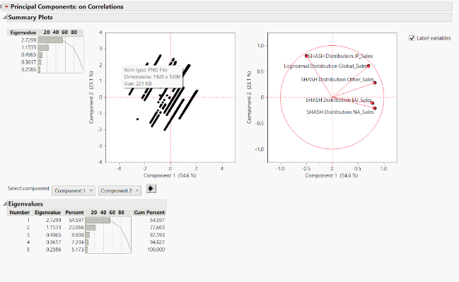
PRINCIPAL COMPONENT ANALYSIS

Slide 11
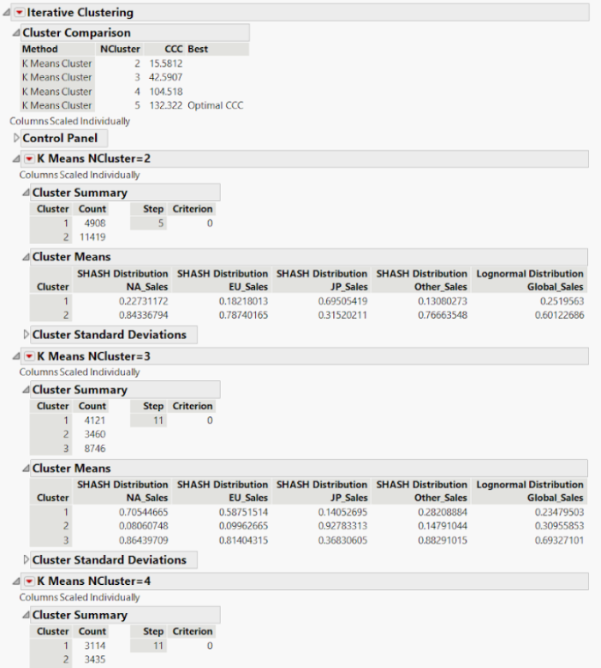
CLUSTERING
High Amount of Global Sales:
North America
Medium Amount of Global Sales:
Europe and Other Regions
Low Amount of Global Sales:
Japan

Slide 12
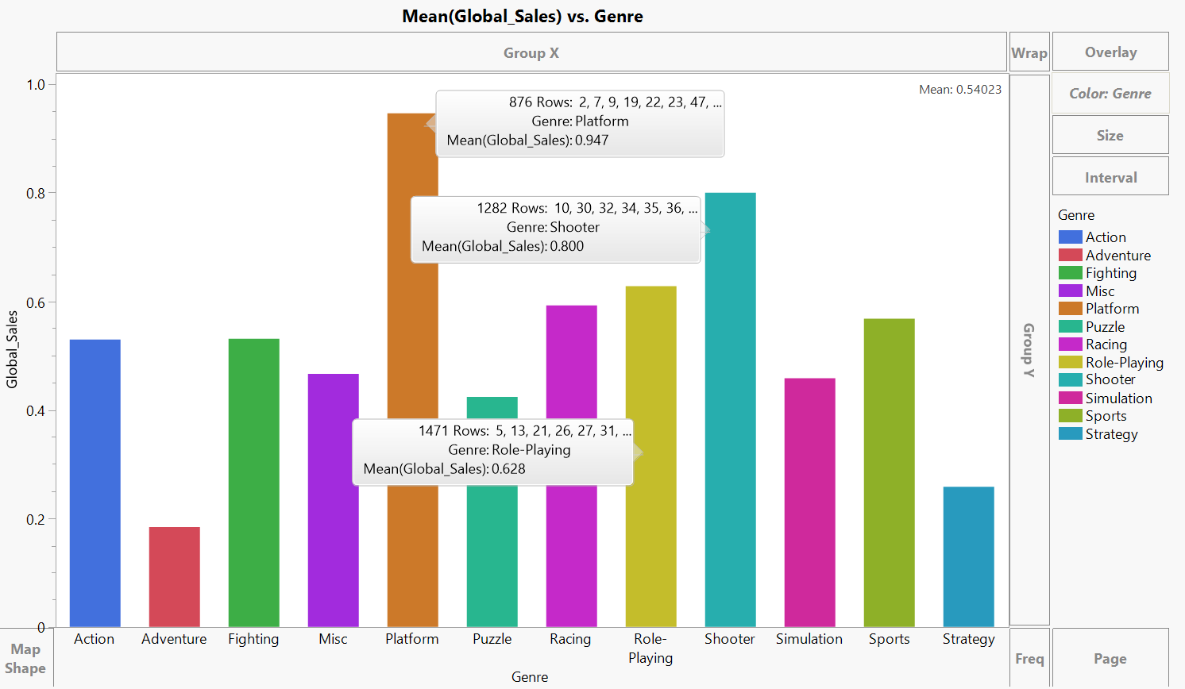
DATA VISUALIZATION

Slide 13
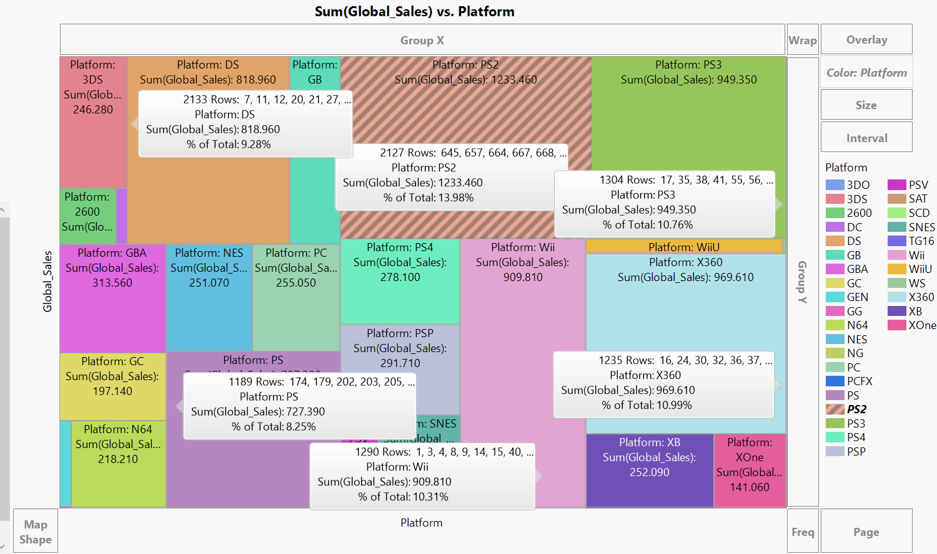
DATA VISUALIZATION

Slide 14
MODEL COMPARISION
Model | RSquare
DECISION TREE | 0.959
BOOTSTRAP FOREST | 0.935
BOOSTED TREE | 0.708
RASE 0.288 0.361 0.771

Slide 15
CONCLUSION
The potential success of the game can be predicted by considering regional preferences, publisher popularity, genre trends, and currently used platforms.
Platform: PS2
Genre: Platform(2D gaming)
Region: North America

Slide 16
THANK YOU

